Slide 1


Data Analysis on Mental Health Impact Due to Social Media
Team Members: Batavia Mahek Guide:prof. Praful Vinayak bhoyar
Kajavadara Tattvam
Khambhati viral
Lakhani Manthan
Patel drashti

Slide 2
Data Analysis on Mental Health Impact Due to Social Media
OUTLINE
Abstract
Problem Statement
Aims, Objective
System Design/Architecture
System Development Approach
Deployment
Conclusion
Future Scope
References
Video of the Project
Notes:
These are the list of chapters that we are going to cover in these foundation codes. Those are chapter one what are AI and ML? chapter 2 applied Python programming in AI, and chapter 3 is exploratory data analysis for ML.

Slide 3
Abstract
Data Analysis on Mental Health Impact Due to Social Media
Social media has become an integral part of daily life, but its impact on mental health remains a growing concern. This study investigates the relationship between social media usage and mental well-being, focusing on its effects on stress, anxiety, and emotional health. Using data analytics techniques, we analyze behavioral patterns, screen time, and content interactions to identify trends and correlations.

Slide 4
Problem Statement
Data Analysis on Mental Health Impact Due to Social Media
The increasing use of social media has raised concerns about its impact on mental health. This study aims to analyze how different aspects of social media consumption correlate with stress, anxiety, and emotional well-being.

Slide 5
Aim and Objective
Data Analysis on Mental Health Impact Due to Social Media
We use data analytics to study the impact of social media on mental health. Through data visualization and statistical analysis, we identify patterns in screen time, online interactions, and mental well-being. The goal is to provide insights for healthier digital habits.
1.Examine the relationship between social media usage and mental health indicators.
2.Analyze the effects of excessive screen time, cyberbullying, and social comparison.
3.Use statistical analysis and data visualization to identify key trends.
4.Provide insights for healthier digital habits.

Slide 6
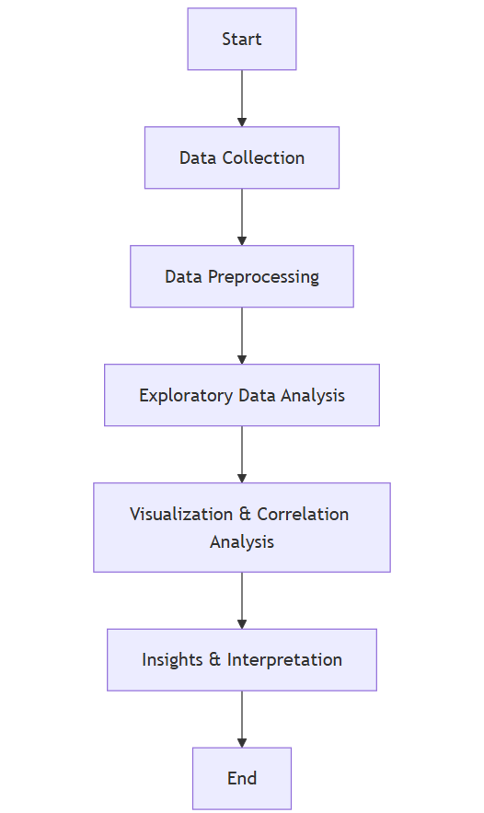
Data Analysis on Mental Health Impact Due to Social Media
System Architecture
The flowchart outlines the data analytics process for studying the mental health impact of social media

Slide 7
System Deployment Approach
Data Analysis on Mental Health Impact Due to Social Media
1. Data Collection
Dataset contains 50,000 records with 23 attributes (numerical & categorical).
Includes factors like Daily Screen Time, Number of Likes, Comments, and Posts per Day.
2. Data Preprocessing
Checked for missing values (none found).
Identified outliers in features.
3. Exploratory Data Analysis (EDA)
Univariate Analysis – Examined distribution of numerical and categorical features.
Bivariate Analysis – Explored relationships between social media usage & mental health indicators.
4. Visualization & Correlation Analysis
Used Bar Charts, and KDA plot to find trends.
Detected correlations between excessive social media use and mental well-being.
5. Insights & Interpretation
Identified patterns linking high screen time & negative mental health effects.
Suggested healthy social media habits based on data-driven findings.

Slide 8
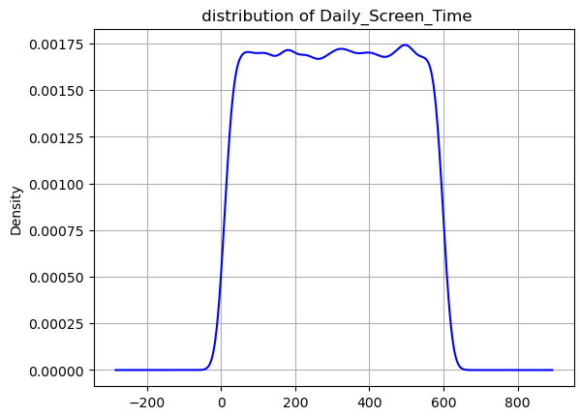
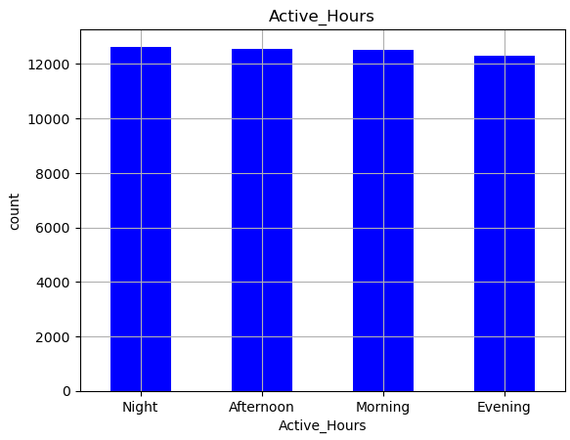
Deployment
Data Analysis on Mental Health Impact Due to Social Media
minimum daily screen time of person is 10
maximum daily screen time of person is 599
average daily screen time of person is 304.51
data is normally distributed
maximum number of users engaged during nighttime
minimum number of users engaged during evening time

Slide 9
Conclusion
Data Analysis on Mental Health Impact Due to Social Media
Social media has both positive and negative effects on mental health.
Excessive screen time and negative interactions (cyberbullying, social comparison) increase stress, anxiety, and depression.
Data analytics plays a crucial role in understanding social media’s impact and providing actionable insights for healthier usage.
Data analytics helps identify patterns and suggest strategies for better digital well-being.
Healthy social media habits and positive engagement (supportive communities) can reduce negative impacts.

Slide 10
Future Scope
Data Analysis on Mental Health Impact Due to Social Media
Real-time Behavioural Monitoring – Track social media usage patterns dynamically for deeper insights.
Machine Learning for Prediction – Implement models to predict mental health risks based on user activity.
User-Centric Recommendations – Develop personalized strategies for improving digital well-being.
Expanded Data Sources – Incorporate data from multiple platforms (Twitter, Instagram, TikTok) for broader analysis.
Longitudinal Research – Conduct extended studies to observe long-term social media effects on mental health.

Slide 11
Data Analysis on Mental Health Impact Due to Social Media
Reference
Reference analysis file :Vacation Data – “Travel and Behaviour Analysis” Provided by Prof. Praful sir
Generated Dataset: (Mental Health & Social Media)"Mental Health Impact Due to Social Media." Dataset generated via ChatGPT
Pandas Documentation: “Pandas: Data Analysis Library." Retrieved from https://pandas.pydata.org/
Seaborn Documentation: “Seaborn: Statistical Data Visualization." Retrieved from https://seaborn.pydata.org/
Matplotlib Documentation: “Matplotlib: Python Plotting Library.“ Retrieved from https://matplotlib.org/
NumPy Documentation: " NumPy: The Fundamental Package for Scientific Computing with Python." Retrieved from https://numpy.org/
Notes:
Reference
These are the references for this session.
11

Slide 12
Data Analysis on Mental Health Impact Due to Social Media
Video of the Project:
https://drive.google.com/file/d/1drsQth1efRxjZb6w_LA_H3Q4fQoedlko/view?usp=sharing
GitHub Repository of this Project:
Drashti2727/Data-Analytics-on-Mental-Health-Impact-Due-to-Social-Media

Slide 13
Data Analysis on Mental Health Impact Due to Social Media
Thank you!
Notes:
thank you very much for joining this PPT, keep learning.
13

